Slide 1

All in the Past
Winston Churchill
Why historians disagree

Slide 2

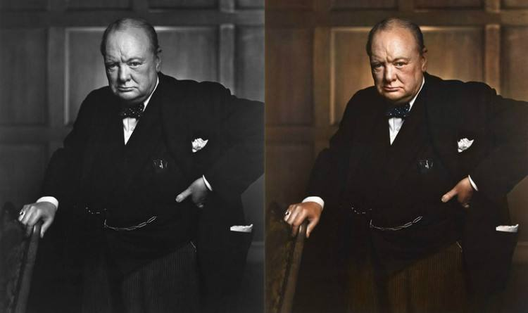
Text Comprehension
Winston Churchill

Slide 3
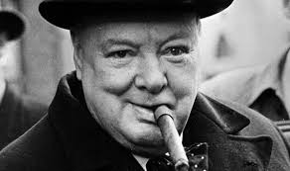
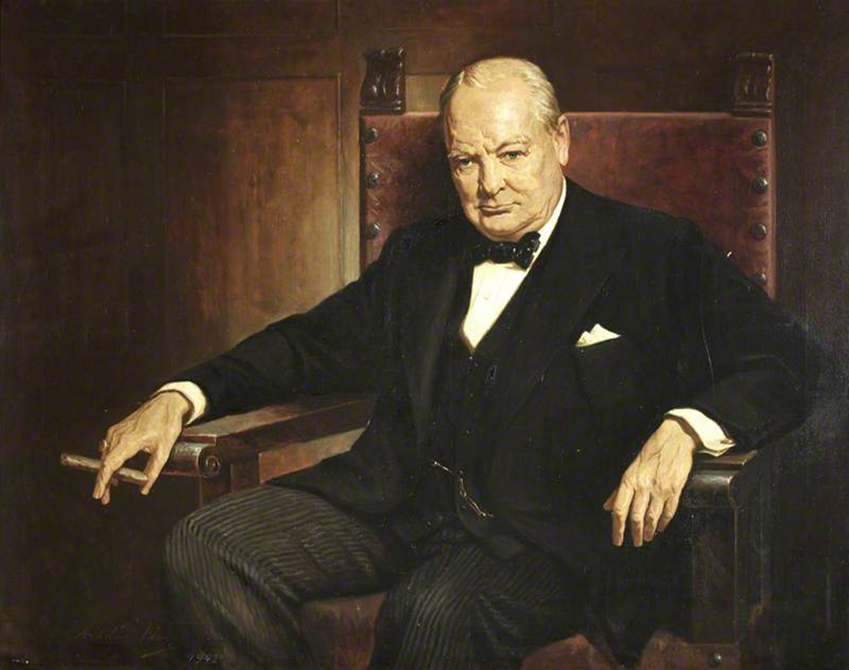
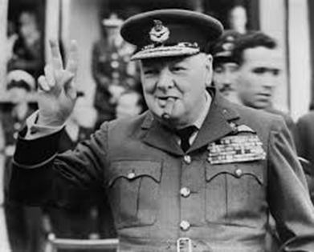
Text Comprehension
Winston Churchill

Slide 4
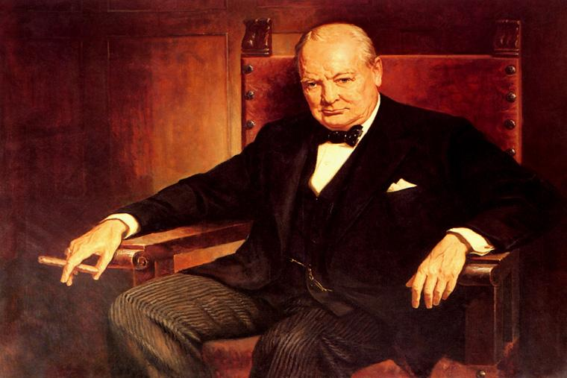
Text Comprehension
Parts of the text:
Introduction
Body
Conclusion

Slide 5
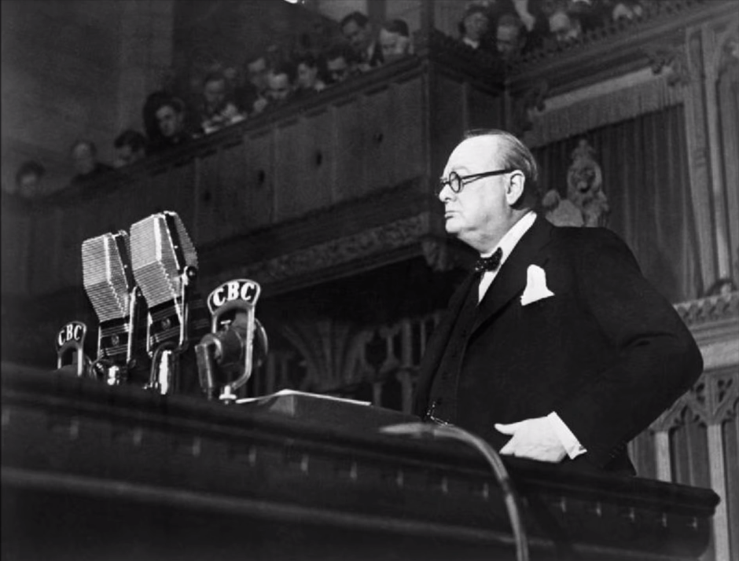
Text Comprehension
"Blood, Toil, Tears, and Sweat" Speech
(May 13, 1940; The House of Commons)

Slide 6
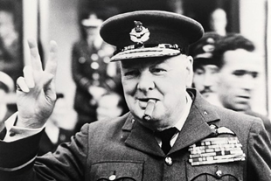

Text Comprehension
“I have nothing to offer but blood, toil, tears and sweat.” (We have before us an ordeal of the most grievous kind. We have before us many, many months of struggle and suffering.)
You ask what is our policy? I can say it is to wage war by sea, land and air, with all our might and with all our strength that God can give us; to wage war against a monstrous tyranny, never surpassed in the dark, lamentable catalogue of human crime.” (That is our policy).
“You ask what is our aim? I can answer in one word: It is victory, victory at all costs, victory in spite of all terror, victory however long and hard the road may be, (for without victory there is no survival).”

Slide 7
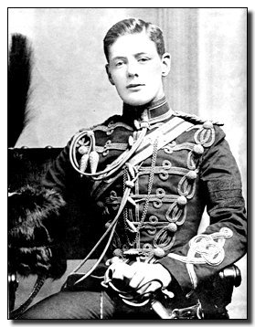
Text Organization
Identify the body.
Winston Churchill’s
early years
Winston Churchill
as a soldier
Winston Churchill
as a statesman
Winston Churchill’s
personality

Slide 8
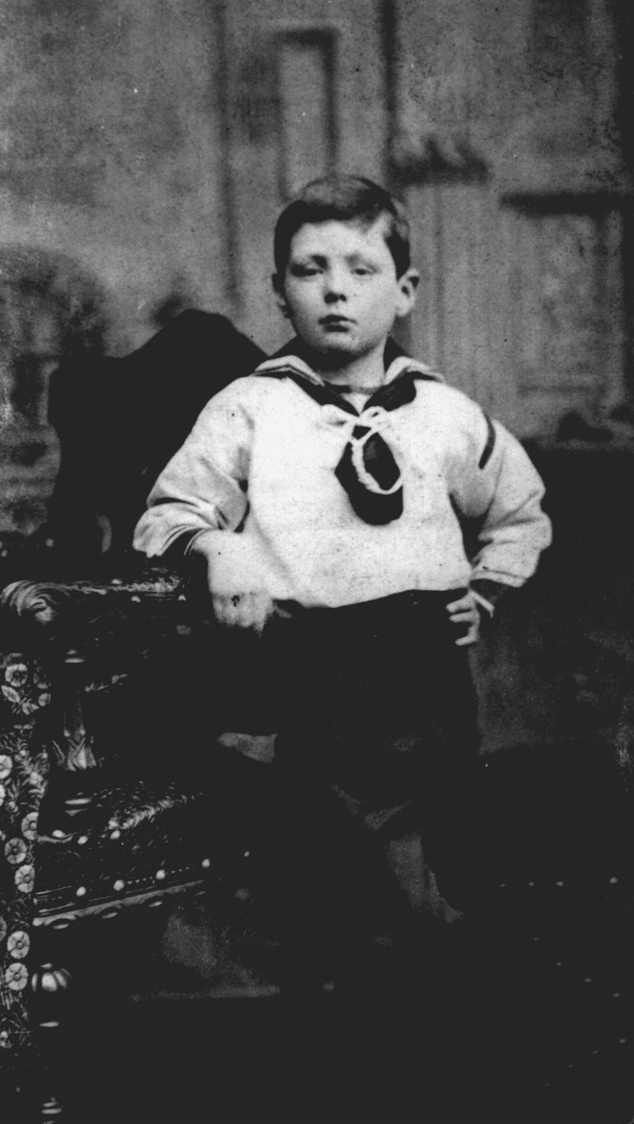
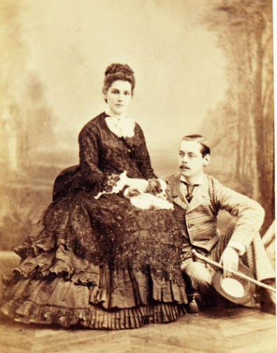
Text Organization
Winston Churchill’s early years

Slide 9
Text Organization
Winston Churchill’s early years
4 Winston Churchill was born in 1874 into one of Britain’s grandest families. The Churchills had been fighting for king and country for generations. Young Winston always believed he’d do the same. But self-belief was something he maintained despite rather than because of his family. His father Lord Randolph Churchill (1849–1895), and his mother, Jennie (1854–1921), were both cold and distant people. Winston was packed off to Harrow. He wasn’t good-looking or clever; he was sickly, with a lisp and a stammer. He was bound to be bullied – and he was. Far from giving support, Winston’s father predicted his child would “degenerate into a shabby, unhappy and futile existence”.

Slide 10
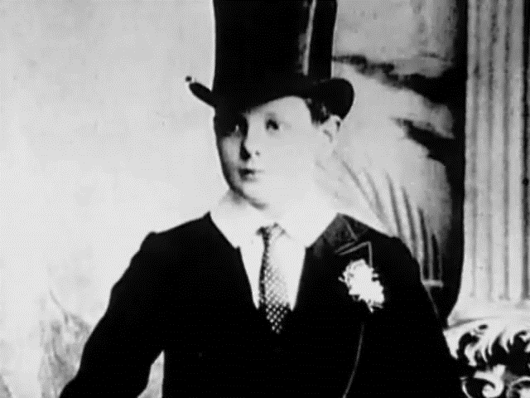
Text Organization
Winston Churchill’s early years

Slide 11
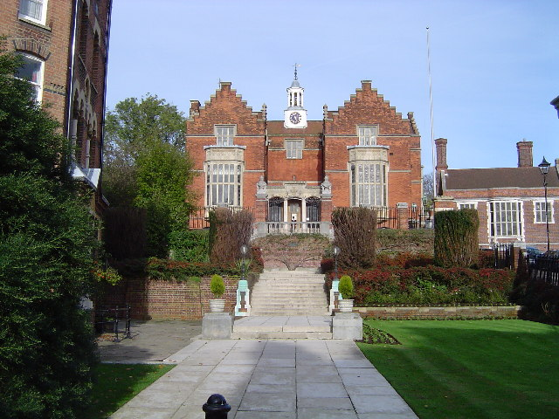
Text Organization
Winston Churchill as a soldier

Slide 12

Military career
Work in pairs and sequence the events in Winston
Churchill’s military career.
8
1
6
2
5
3
4
7
revived the V sign for victory of WWII
his ambition of being a general
failure at Gallipoli, Turkey
military academy at Sandhurst
First Lord of the Admiralty
war correspondent
a hero of the Boer War
in the trenches of France

Slide 13
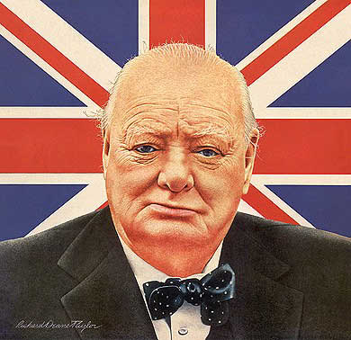
Military career
The events in Winston Churchill’s military career are as
follows.
1. his ambition of being a general (Para 7)
2. military academy at Sandhurst (Para 5)
3. war correspondent (Para 5)
4. a hero of the Boer War (Para 5)
5. First Lord of the Admiralty (Para 7)
6. failure at Gallipoli, Turkey (Paras7&8)
7. in the trenches of France (Para 8)
8. revived the V sign for victory of WWII (Para 11)

Slide 14

Military career
The events in Winston Churchill’s military career are as
follows.
1. his ambition of being a general (Para 7)
7. But then he’d always wanted to be a general. This ambition dated back to the days when he spent his school holidays playing with toy soldiers in the corridors of Blenheim Palace, below the tapestries of his heroic ancestors.

Slide 15
Political career
Work in pairs and match the years with the events in Winston Churchill’s political career.
1900
1911
1920s
1930
1930s
1940-1945
1945
1951-1955
lost general election
Chancellor of the Exchequer
on the backbenches
First Lord of the Admiralty
a Tory MP
his country retreat Chartwell
British Prime Mininster

Slide 16

1900
the beginning of Winston Churchill’s political career
6 He was elected as Tory MP for Oldham in the same year. Then he swapped to the Liberals, then back. He was never really a Party animal. He cared about Britain. His vision was of a place with better living standards for ordinary people, but with a fierce regard for law and order. Though he wasn’t a vicious man, Churchill’s attitude to suffragettes, trade unionists or anyone who challenged the system was brutal. His weapon of first resort was the army.

Slide 17
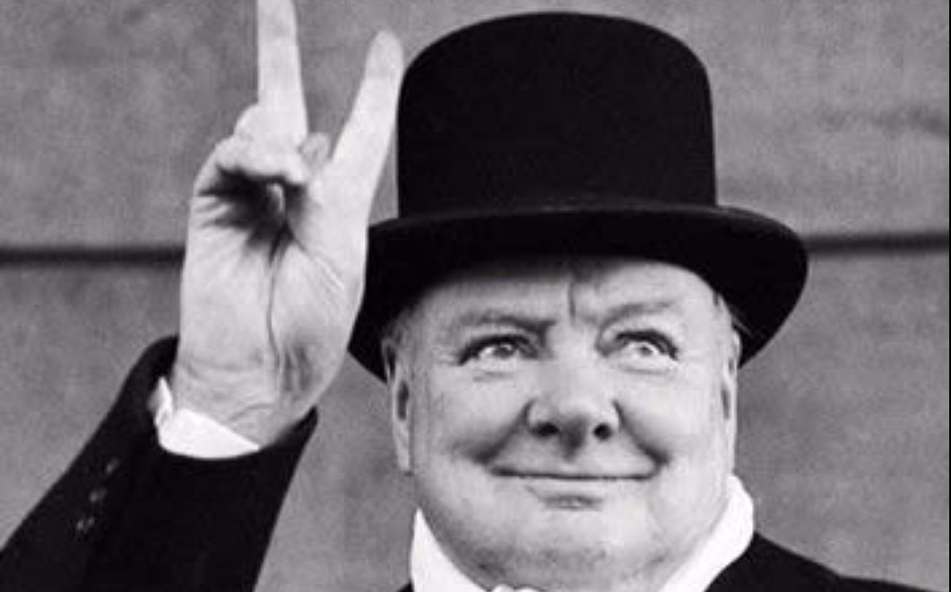
1945
lost general election
12 … When victory was finally declared in Europe on 8 May 1945, it was quickly followed by a general election. The billboards said “Cheer Churchill, Vote Labour”, and that’s what people did. That was the irony. The very democracy that Churchill was prepared to lay down his life to defend was the same democracy that knew the difference between the needs of peace and the needs of war.

Slide 18
Difficult Sentences
1. Far from giving support, Winston’s father predicted his child would “degenerate into a shabby, unhappy and futile existence”. (Para.4)
2. But by 1930, Labour was in power and he was on the backbenches, a nobody and a has-been. (Para. 9)
3. The billboards said “Cheer Churchill, Vote Labour”, and that’s what people did. (Para. 12)
4. That was the irony. The very democracy that Churchill was prepared to lay down his life to defend was the same democracy that knew the difference between the needs of peace and the needs of war. (Para. 12)
5. If Britain – its eccentricity, its strength of character, its big-heartedness – had to be summed up in one person, it was him. (Para. 13)

Slide 19

1. Far from giving support, Winston’s father predicted his child would “degenerate into a shabby, unhappy and futile existence”. (Para 4)
Translate the sentence.
温斯顿的父亲不仅没有给他支持和帮助，还预测他的儿子将来会“沦落到穷困潦倒、一事无成、抑郁而终的地步”。

Slide 20
2. But by 1930, Labour was in power and he was on the backbenches, a nobody and a has-been. (Para 9)
Paraphrase the sentence.
But by 1930, Labour Party came to power and Sir Winston Churchill was a member of Parliament without a government position (ministers sit on the front row of seats / benches and their followers and supporters behind them). He was also a person of no importance in politics, and someone with only a past, not present or future.
1930年，工党开始执政，而他只是一名后座议员，一个无足轻重的小人物，一名过气的政客。

Slide 21
3. The billboards said “Cheer Churchill, Vote Labour”, and that’s what people did. (Para 12)
Paraphrase the sentence.
During elections large posters are put up. The Labour Party, Winston’s opponents in the election, did not attack him personally. They said it was correct to like and admire Winston, but not to vote for his party which did not have good policies,and people agreed.
英国许多告示牌上都写着“为丘吉尔喝彩，给工党投票”，而人们也确实是这么做的。

Slide 22
4. That was the irony. The very democracy that Churchill was prepared to lay down his life to defend was the same democracy that knew the difference between the needs of peace and the needs of war. (Para 12)
Translate the sentence.
这真是充满了讽刺意味。丘吉尔随时准备誓死保卫的民主国家明白和平时代的需求和战时的需求是不一样的。

Slide 23
5. If Britain – its eccentricity, its strength of character, its big-heartedness – had to be summed up in one person, it was him. (Para 13)
Paraphrase the sentence.
Britain has always valued individuals who behave in their own unique way, people who are not easily persuaded to do what they don’t want to, and who accept others in a spirit of generosity. In this way, Churchill can be seen as being the model Briton.
如果要用一个人来代表英国的怪僻、坚强的个性和宽广的胸怀，那就是丘吉尔。

Slide 24
Words & Expressions
Words & Phrases
tolerant a. willing to accept other people’s beliefs, way of life etc. without criticizing them, even if you disagree with them 容忍的；宽容的
e.g.
1. Closely related with this is the capacity to be tolerant — not, indeed, of what is wrong, but of the weaknesses and immaturity of human nature which induce people, and again especially children, to make mistakes. (CET4-2003-06)
与此密切相关的是容忍的能力——当然，不是容忍错误，而是容忍人性的弱点和不成熟，正是这些弱点和不成熟使得人们，尤其是儿童，犯错误。
Word family: tolerance n. tolerantly adv.

Slide 25

2. They need to be tolerant of different points of view.
他们需要容忍不同的观点。
fault-tolerant
drought-tolerant
error-tolerant
salt-tolerant
delay-tolerant
frost-tolerant
search
crops
data transfer
refrigerator
person
plants
Work in pairs. Match the adjective-noun collocations.

Slide 26
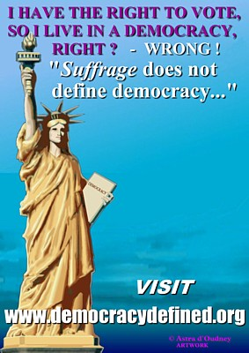
democracy n.
a system of government in which people vote in elections to choose the people who will govern them
Antonym: autocracy
Word family: democratic a.
democrat n.

Slide 27

Work in pairs and complete the sentences with democracy, democratic and democrat.
1. The election seems a test for _____________.
2. Compared with the existing electoral arrangements, does it represent progress towards greater ________________?
3. He is the _____________ Party leader.
4. They backed the _______________ in the election.
democracy
democracy
Democratic
democrats

Slide 28
Words & Phrases
might n. [U] great power or strength, especially a country’s military or economic power 力量；威力
e.g.
1. Their foreign policy is based on the principle that “might is right”.
他们的外交政策建立在“强权即公理”的原则之上。
2. To be frank, this mission is beyond my might.
坦白说，这一使命非我能力所及。
3. He fought back with all his might.
他全力反击。
Word family: mighty a.

Slide 29
Words & Phrases
surpass vt. to be better or greater than sth. else 优于，超过（某事物）
e.g.
1. We will surpass our predecessors, and future generations will certainly surpass us.
我们会超过前人，后人也必然会超过我们。
2. The task surpassed his skill.
这项工作超出了他的能力范围。
3. The second half of the match comfortably surpassed the first in entertainment value.
下半场比赛的精彩程度远胜于上半场。

Slide 30
Generally, the sentences with surpass can be paraphrased by the out + verb pattern, or exceed, or be beyond.
Work in pairs and paraphrase the sentences.
1. Jack’s weight surpassed that of his father.
Jack outweighs his father.
2. What they have done has surpassed my optimistic expectations.
What they have done has exceeded my optimistic expectations.
3. The theory surpassed my comprehension.
The theory was beyond me.

Slide 31
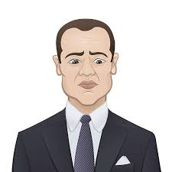
Words & Phrases
lamentable a. (fml) so bad that you feel disappointed or angry 令人痛惜的；糟糕的
e.g.
1. The decision they made is a lamentable lack of foresight.
他们做的决定实在缺乏远见。
2. His death is a lamentable loss of our work.
他的死对我们的工作来说是令人悲痛的损失。
3. Nothing is more lamentable than a dead heart.
哀莫大于心死。
Word family: lamentation n.
lamentably ad.
lament v. & n.

Slide 32
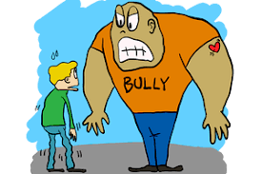
bully
v. to frighten or hurt someone who is smaller and weaker than you
n. someone who frightens or hurts someone who is smaller or weaker than they are 持强凌弱者
Work in pairs and familiarise you with the situations where bully occurs. Spot more situations.
the office
School
Class
playground

Slide 33


Bully-related suicide is a serious social issue. Here are some anti-bullying posters.
Work in pairs and spot the collocations.

Slide 34
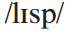
Words & Phrases
lisp n. [C, sing] a speech defect or mannerism characterized by mispronunciation of the sounds (s) and (z) as (th) and (th) 咬舌，口齿不清
e.g.
1. We had trouble not laughing at his lisp.
我们很难不去笑他的口齿不清。
2. We should not blame those who cannot speak English well because of a physical defect such as a natural lisp, stutter or dyslexia.
因身体缺陷如天生口齿不清、结巴、诵读困难等而不能讲好英语者，我们不应当责怪。

Slide 35
Words & Phrases
degenerate vi. to become worse 恶化；堕落；退化
e.g.
1. Liberty is apt to degenerate into lawlessness.
自由容易沦为无法无天。
2. We must not allow our creative protest to degenerate into physical violence.
我们不能容许我们富有创造性的抗议沦为暴力行动。
3. He denied that some young people today were degenerating.
他否认现在某些青年在堕落。

Slide 36
degenerate
v. to become worse
adj. immoral; in a worse state than before
n. someone whose behaviour is shocking or immoral
Work in pairs and identify the part of speech.
1. degenerate art
2. His condition continued to degenerate even after admission to hospital.
3. a degenerate lifestyle
4. You are a degenerate, boy. You’re a disgrace to your ancestors.
adjective
verb
adjective
noun

Slide 37
Words & Phrases
suffragette n. [C] in the UK and US a woman who took part in public protests about giving women the right to vote in the early 1900s（20世纪初英美两国）为女性争取选举权的女子
e.g.
1. In July 1909, imprisoned English suffragette Marion Dunlop refused to eat.
1909年7月，被逮捕的英国女权主义者马里恩·邓洛普开始绝食。
2. After women obtained the right to vote, the suffragette movement became a dead duck in Britain.
妇女获得选举权后，鼓吹妇女参政的妇女运动在英国成了不能再引起人们兴趣的问题了。

Slide 38
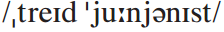
Words & Phrases
trade unionist n. [C] (BrE) a member of a trade union; an advocate or supporter of trade unions
工会主义者
e.g.
1. The employers and the two trade unionists had a warm debate for three hours, then the former had to lower their colours.
雇主们和两个工会代表激烈地争辩了3个小时，后来雇主们不得不让步。
2. Attempts to suppress trade unionists by savage economic measures are often counter-productive.
企图通过野蛮经济手段镇压工会主义者往往事与愿违。

Slide 39
Words & Phrases
onset n. [sing] the beginning of sth., especially sth. bad （尤指某种坏事情的）开始，发作
e.g.
1. He went to see a doctor at the onset of a fever.
他一发烧便去看医生了。
2. His first hit record marked the onset of an astonishing career.
他的第一张风行一时的唱片标志着惊人事业的开始。
3. With the onset of a global knowledge economy, Hong Kong is going through a process of economic restructuring.
随着全球经济趋向以知识为本，香港现正经历经济转型。

Slide 40
Work in pairs and translate the sentences.
1. withstand the onset of the army
2. The onset of winter is radical with very short autumn as a transition.
3. adult-onset disease
4. juvenile-onset disease
抵抗敌人的袭击
只有非常短的秋天作为过渡，冬天开始得太突然。
从成年时期开始发作的疾病
从青年时期开始发作的疾病

Slide 41
Words & Phrases
unswervingly ad. used for emphasizing how strong sb.’s feelings continue to be in difficult situations 坚持不懈地；坚定不移地
e.g.
1. We will unswervingly pursue an independent foreign policy of peace.
我们将始终不渝地奉行独立自主的和平外交政策。
2. We will continue to adhere unswervingly to the policy of reform and opening, which is the only way to invigorate the country.
我们要继续坚定不移地推进改革开放，这是唯一的强国之路。
Word family: unswerving a.

Slide 42
Words & Phrases
backbench n. [C] (BrE) one of the seats in the British Parliament where ordinary Members of Parliament sit （英国下院的）后座议员席，普通议员席
Ministers and the leading members of opposition parties sit on the front benches.
e.g.
My own view is that “backbench” councillors are well paid, but Board Members earn every penny.
我的观点是“普通”议员收入很高，而委员会成员却得辛苦挣每一分钱。

Slide 43
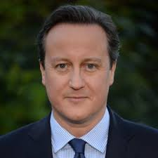
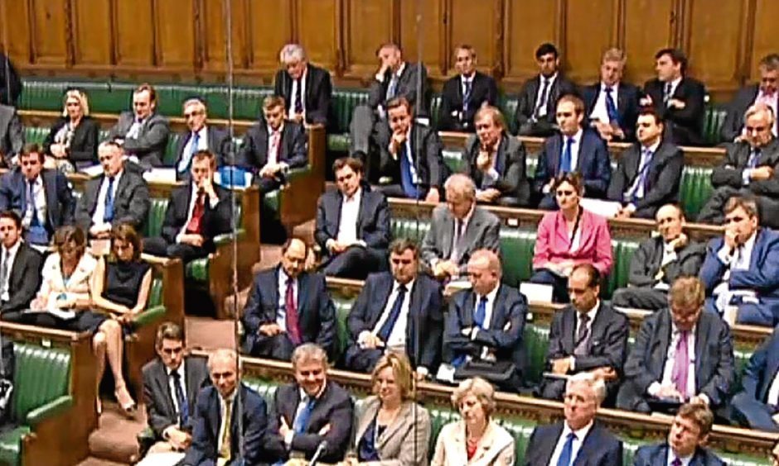
Words & Phrases
backbench

Slide 44

Words & Phrases
has-been n. [C] an insulting word for sb. who was important or famous in the past but is not now（侮辱性用语）过气的名人，曾经红极一时的人物
e.g.
1. He is an aging has-been. No one will hire him any more.
他是一位年老的过气名人，没人会再雇佣他。
2. It is better to be a has-been than a never-was.
宁可昙花一现，不能默默无闻。

Slide 45
retreat
n. a peaceful and private place where you can go in order to rest
v. to avoid a dangerous, unpleasant or embarrassing situation, esp by moving away from it
Work in pairs and translate the sentences.
1. Built into her schedule will be weekend retreats.
周末静养将列入她的日程。
2. Embarrassed, the kids retreated into silence.
感到尴尬，孩子们退到一边不吭声。
3. The five-day retreat energised the team members.
五天的休养使团队成员精力充沛。

Slide 46
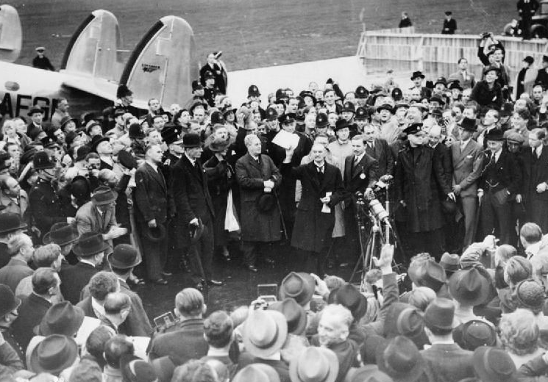
Words & Phrases
brandish vt. to wave a weapon or other object around in your hand so that other people can see it 挥舞（武器等）
e.g.
1. The old man brandishes his walking stick at the menace dog.
老人对着那条要咬他的狗挥舞手杖吓它走。
2. The demonstrators brandished banners and shouted slogans.
示威者挥舞着旗帜，呼喊着口号。
Chamberlain brandished an agreement he’d signed with Adolf Hitler

Slide 47
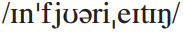
Words & Phrases
infuriating a. extremely annoying 使人大怒的；使人极为愤怒的
e.g.
1. Don’t you think that the unsolicited calls at night are infuriating?
你不觉得深夜时分不速之客打来的电话极其招人嫌吗？
2. One of the most infuriating aspects of spam is that it changes continually to adapt to new attempts to stop it.
垃圾邮件最令人生气的地方，在于它会不断变化，以适应各种新的拦阻方法。

Slide 48
Words & Phrases
irony n.
1. [C, U] a strange, funny, or sad situation in which things happen in the opposite way to what you would expect 具有讽刺意味的事；出乎意料的事；啼笑皆非的事
e.g.
1. The great irony was that despite all his explanations nobody believed him.
最具讽刺意味的是：尽管他竭力解释，可没一个人相信他。
2. History has many ironies.
历史上有许多充满讽刺意味的事。

Slide 49
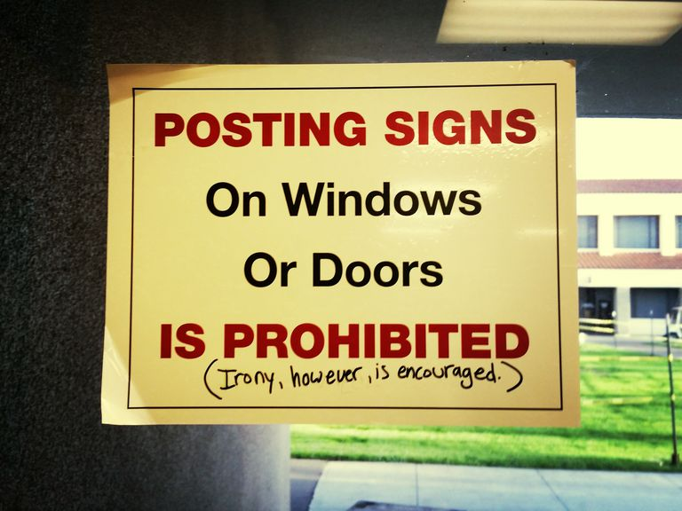
Words & Phrases
2. [U] a form of humour in which you use words to express the opposite of what the words really mean 反语；反话；讥讽
e.g.
1. The phrase is loaded with irony.
此语满含讽刺意味。
2. She said to him with slight irony.
她略带嘲讽地对他说。
3. I glanced at her and saw no hint of
irony on her face.
我瞥了她一眼，没有在她的脸上
看到一丝嘲弄。

Slide 50
Words & Phrases
eccentricity n. [U] strange or unusual behaviour 古怪行为
e.g.
1. Here are a few stories which indicate the originality, not to say eccentricity, of his character.
这里有几个故事，表明了他独特而非怪僻的性格。
2. His eccentricity was a stubborn reluctance to entrust his savings to a bank.
他的怪癖是坚决不愿把钱存入银行。
Word family: eccentric a.

Slide 51
Words & Phrases
big-heartedness n. [U] the quality of being kind and generous towards other people 仁慈；慷慨；宽宏大量
e.g. He leaves an indelible impression of big-heartedness on many people.
他给很多人留下了宽宏大量的深刻印象。
Word family: big-hearted a.
e.g. The mean-hearted artist cannot produce a great painting, and a big-hearted artist cannot produce a mean picture, even if his life were at stake.
纵使生死攸关，心地卑劣的艺术家不能创作出伟大的画作，心胸宽广的艺术家也不会创作出下劣的作品。

Slide 52
Words & Phrases
on the brink of (doing) sth.: almost in a very new, dangerous or exciting situation 在…的边缘
e.g.
1. She believed she was on the brink of discovering a cure for cancer.
她相信自己快要找到治愈癌症的方法了。
2. We’re often told that the world is tethering on the brink of destruction .
我们经常被告知世界处于毁灭的边缘。
3. The stock market was on the brink of collapse.
股市已到崩盘的边缘。

Slide 53
pack off
infml to send someone away somewhere suddenly
Work in pairs and translate the sentences.
To avoid family disgrace, Frank was packed off to India.
2. Laura just packed all the kids off to summer camp.
3. I will pack the books off to you immediately.
为避家丑，弗兰克被匆匆送往印度。
罗娜催促孩子去夏令营。
我将立刻把这些书送给你。

Slide 54
Words & Phrases
double (up) as: to have another use or job as sth. 兼作；兼任
e.g.
1. In the corner was an old sofa that doubled (up) as Simon’s bed.
角落里有张旧沙发，兼作西蒙的床。
2. The Prime Minister doubles (up) as Minister of Finance.
总理兼任财政部长。
3. Lots of homes in town double as businesses.
镇里的很多民宅还兼做商用。

Slide 55
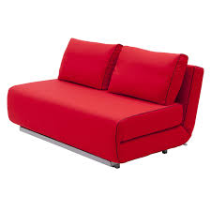
Work in pairs and answer the questions.
1. What did Simon’s old sofa double as?
It doubled as Simon’s bed.
2. What can cell phones double as?
Cell phones can double as night vision devices.
3. What can smart IDs double as?
Smart IDs can double as debit cards.

Slide 56

Words & Phrases
law and order: safe and peaceful conditions in society that result when people obey the law 法治；治安
e.g.
1. The police are guardians of law and order.
警察是法律治的护卫者。
2. In order to keep law and order, every one
of us is supposed to get a law education.
为了维护社会治安，我们每个人都应该接受法制教育。

Slide 57
date back to
to be made or begun at particular time in the past
Work in pairs and translate the sentences.
1. The history of hockey can date back to thousands of years ago.
曲棍球的历史可追溯于数千年前。
2. 该城堡建于14世纪。
The castle dates back to the 14th century.
3. The history of the town dates back to the Middle Ages.
这个城镇的历史可回溯到中世纪。

Slide 58

get sb. out of
to help sb. avoid doing sth.
Work in pairs and translate the sentences.
1. 他帮我逃避出席那个婚礼。
He got me out of going to that wedding.
2. 凯西已经帮他改掉了这个坏习惯。
Cathy has got him out of the bad habit.
3. 你能帮我逃过这次约会吗？
Can you get me out of this appointment?

Slide 59
take off
Work in pairs and match the meanings.
a. to leave a place suddenly
b. to remove sth., esp a piece of clothing
c. (of airplane) to leave the ground and start flying
d. to copy the way someone speaks or behaves, in order to entertain people
1. Beth can take off Judy brilliantly.
2. The plane will take off soon.
3. He took off his raincoat and took out the key.
4. At the sight of Maria, she took off as soon as possible.
4. a 3. b 2. c 1.d

Slide 60
sit out
to stop doing sth. for a period of time 坐在一旁不参加
to stay until the end of sth., esp if you are not enjoying it
一直坐到（不愉快之事）结束
Work in pairs and match the meanings with the sentences.
1. I’m tired, so I think I’ll sit out the next dance.
2. We decided to sit out the lecture instead of leaving early.
3. The player will sit out the World Champions as a result of serious injury.
4. I know it’s boring, but we’re just going to have to sit it out.
a
b
b
b

Slide 61

lay down
Work in pairs and match the meanings.
1. Please stop writing and lay down your pencils.
2. The EU has laid down tough standards for water quality.
3. They laid down their arms.
a. to put sth. down to show you are finished with it
b. to state officially what someone must do or how they must do it
1.a 2. b 3. a

Slide 62
sum up
a. to give a summary of sth.
b. to make a judgment about what someone or sth. is like
Work in pairs and answer the questions.
1. We have to sum up the costs of production.
2. Let’s sum up our experience before going on.
3. Her reply seemed to sum up the attitude of all the refugees.
1.a 2. b 3. b

Slide 63
Useful Expressions
1.面临外敌入侵，孤立无援
1. stand alone on the brink of invasion
2.宽容而坚忍的
2. tolerant and long-suffering
3.冷漠、拒人于千里之外的
3. cold and distant
4.兼任战地记者
4. double up as a war correspondent
5.保守党国会议员
5. a Tory MP
6.热衷于党派斗争的人
6. a Party animal
7.工会主义者
7. trade unionist
8.第一海军大臣
8. First Lord of the Admiralty
9.军事攻势
9. military offensive
10.丢掉了饭碗
10. cost sb. his / her job

Slide 64

11.严重的抑郁症
11. major bout of depression
12.弥补他的过失
12. make amends for one’s mistake
13.为战争而生的人
13. a man made for war
14.身居高位
14. hold high office
15.财务大臣
15. Chancellor of the Exchequer
16.挥舞着协议·
16. brandish an agreement
17.确保和平
17. secure peace
18.如释重负地松了一口气
18. the sighs of relief
19.天降大任于斯
19. destiny has arrived
20.战争领袖
20. war leader

Slide 65

21.工作起来不要命
21. limitless capacity for hard work
22.喝起酒来不要命
22. limitless capacity for hard liquor
23.大选
23. general election
24.为丘吉尔喝彩
24. Cheer Churchill
25.给工党投票
25. Vote Labour
26.进入摇滚乐时代的英国
26. the rock-and-roll Britain
1945 Election Poster

Slide 66
